Slide 1
Weather monitoring

Slide 2
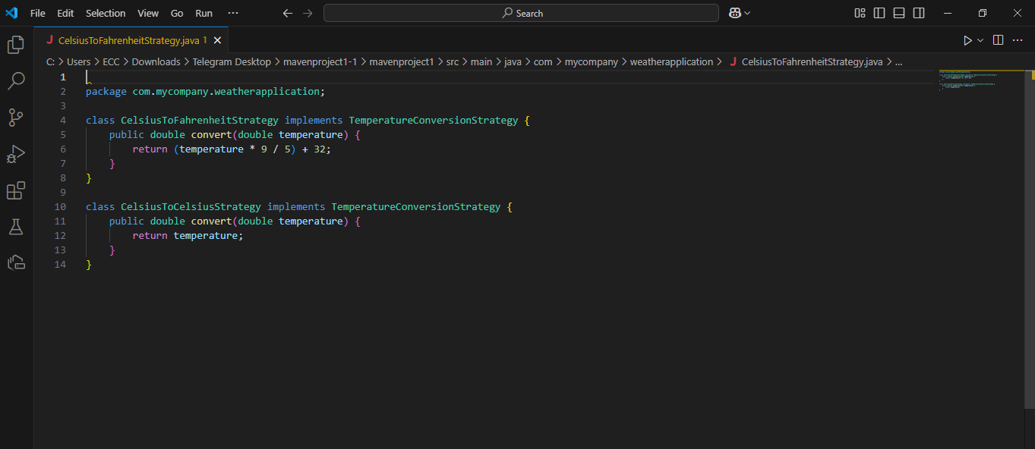
This code defines two strategies for converting temperatures:
CelsiusToFahrenheitStrategy: Converts a temperature from Celsius to Fahrenheit using the formula:
Fahrenheit=(Celsius×95)+32\text{Fahrenheit} = (\text{Celsius} \times \frac{9}{5}) + 32Fahrenheit=(Celsius×59​)+32
CelsiusToCelsiusStrategy: Returns the temperature as-is, without any conversion.
Both classes follow a shared interface, TemperatureConversionStrategy, ensuring they have a convert method for consistent usage in different scenarios.

Slide 3
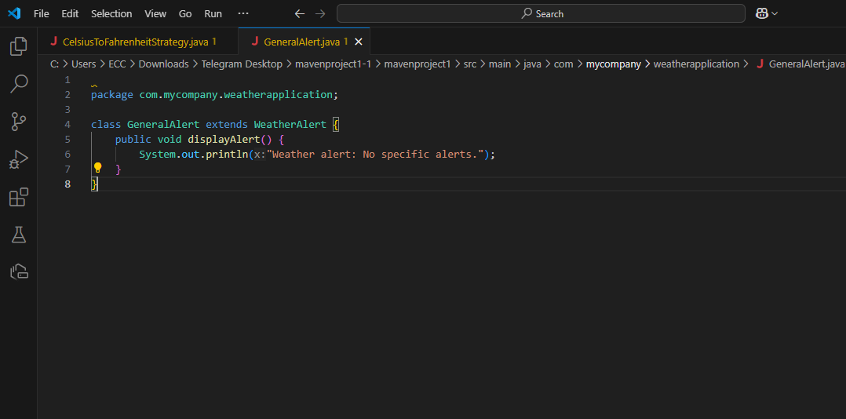
This code defines a class GeneralAlert that extends a parent class WeatherAlert.
Purpose: The GeneralAlert class represents a generic weather alert with no specific warnings or details.
displayAlert Method: Prints a default message:
Weather alert: No specific alerts.
It’s a basic implementation for situations where no specific weather conditions require attention.

Slide 4
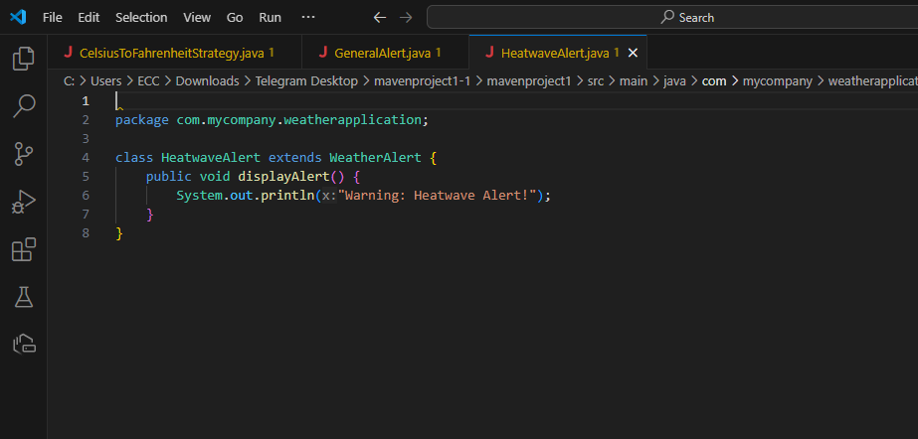
This code defines a class HeatwaveAlert that extends a parent class WeatherAlert.
Purpose: The HeatwaveAlert class represents a weather alert specifically for heatwaves.
displayAlert Method: Prints a warning message:
Warning: Heatwave Alert!
It’s used to notify users about extreme heat conditions that may require caution.

Slide 5
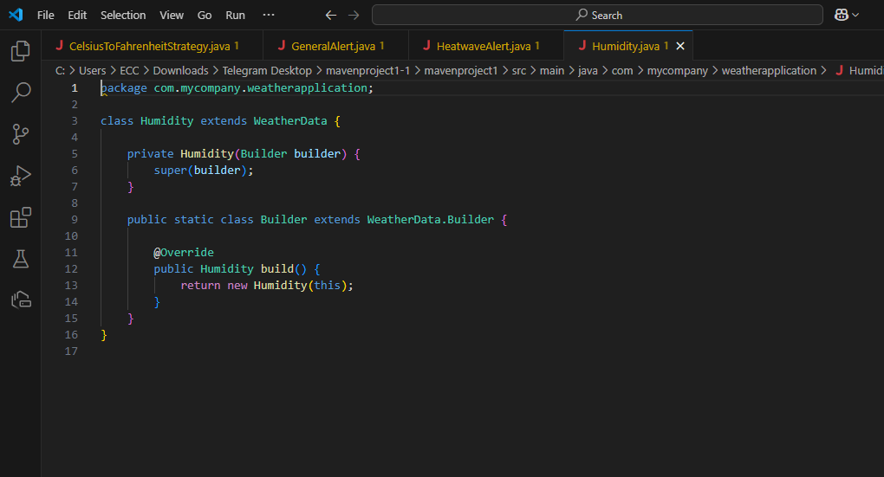
This code defines a Humidity class to represent humidity-related weather data. It uses the Builder Design Pattern for creating objects step-by-step.
Key Points:
Humidity Class:
Extends a parent class WeatherData (assumed to store general weather data).
The constructor is private to enforce the use of the builder for object creation.
Builder Class:
A static nested class that extends WeatherData.Builder.
Implements the build() method to create a new Humidity object.
How It Works:
The Builder Pattern allows for flexible and controlled construction of Humidity objects by customizing properties in the builder before calling build().

Slide 6
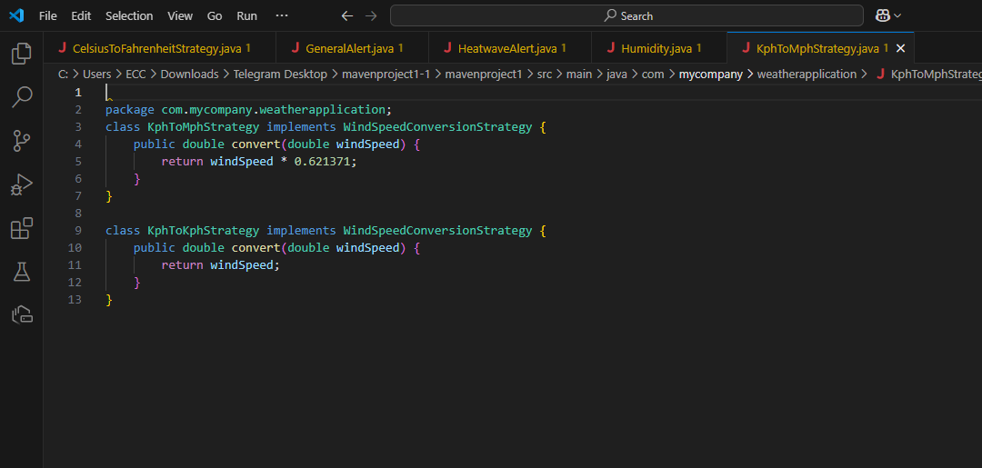
This code defines two strategies for wind speed conversion:
KphToMphStrategy: Converts wind speed from kilometers per hour (kph) to miles per hour (mph) using a conversion factor of 0.621371.
KphToKphStrategy: Returns the wind speed as-is, without any conversion.
Both strategies follow a common interface to ensure consistent implementation and allow dynamic selection of the desired conversion method.

Slide 7
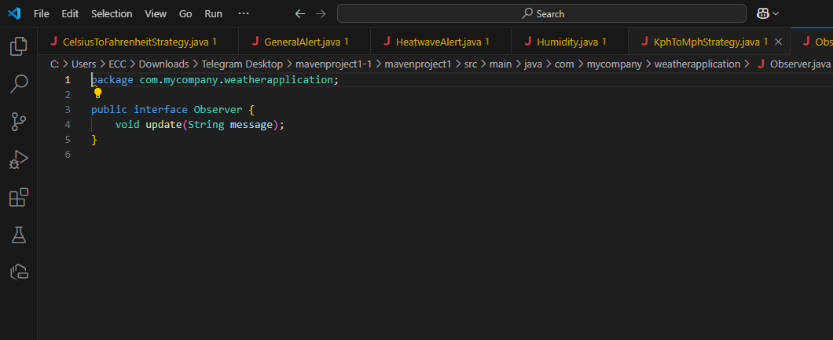
This code defines an Observer interface for implementing the Observer Design Pattern.
Purpose: The interface is used to create objects (observers) that "listen" for updates or changes from another object (subject).
update Method: Any class implementing this interface will define what happens when it receives a message or notification.
This structure helps in notifying multiple objects automatically whenever a change occurs in the subject.

Slide 8
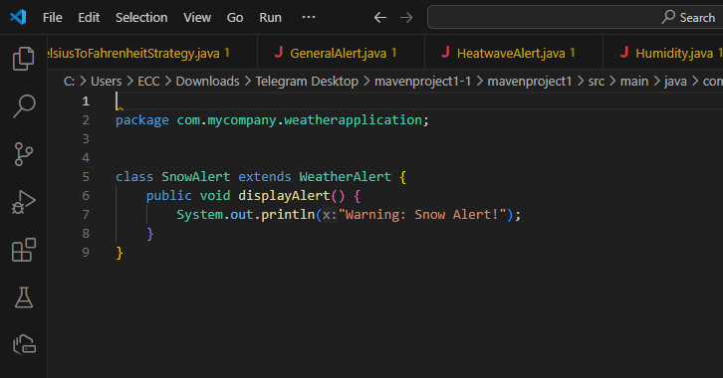
The SnowAlert class represents a weather alert specifically for snowy conditions.
It extends a parent class that likely handles general weather alerts.
It displays a specific warning message to notify users about snow-related weather hazards.

Slide 9
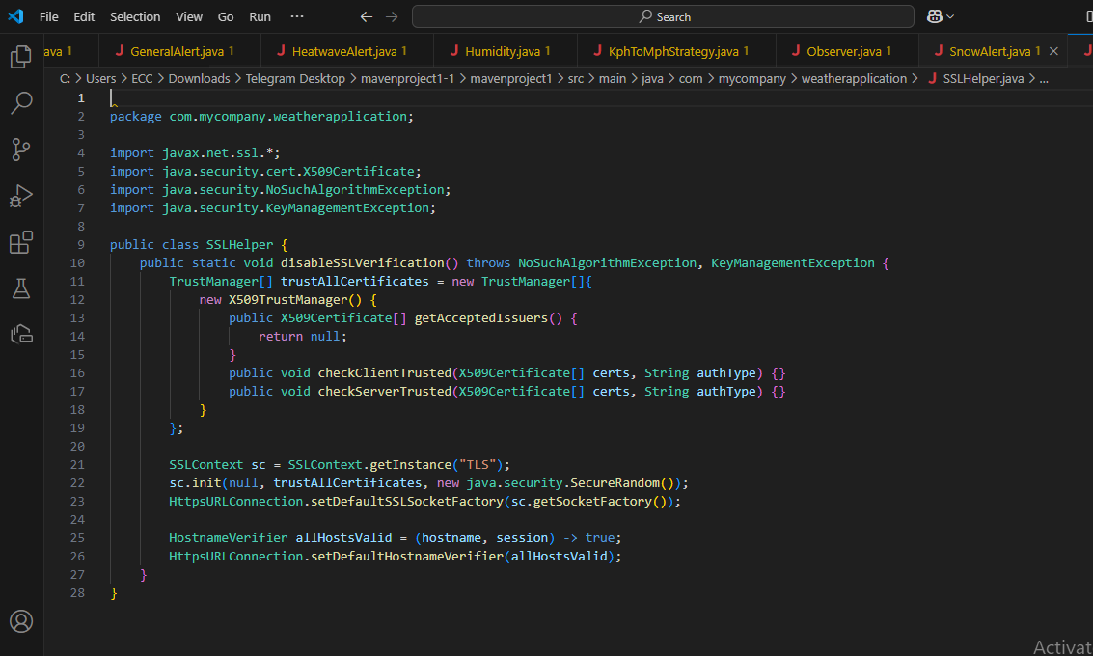
This code defines a class SSLHelper with a method to disable SSL verification.
Purpose:
It modifies the default SSL (Secure Socket Layer) behavior to accept all SSL certificates without validation. This is typically used in situations where you want to bypass SSL checks, such as in testing environments.
Key Actions:
Disables SSL verification: It allows the application to trust all SSL certificates, even those that would normally be untrusted or self-signed.
Disables hostname verification: It skips checks for verifying if the server’s hostname matches the SSL certificate.
Use Case:
This method can be useful in cases where you need to work with servers that use self-signed certificates or when SSL verification is not a priority (e.g., during development or testing). However, it reduces security and should not be used in production environments.

Slide 10
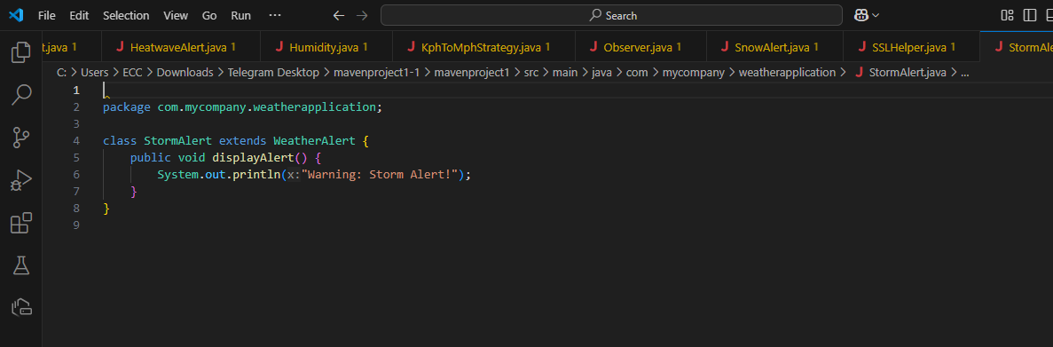
The StormAlert class is a type of weather alert specifically for storm warnings.
It extends a parent class, likely designed to handle general weather alerts.
The class has a method to display a specific message: "Warning: Storm Alert!" to inform users about an impending storm.
This is used to notify users about stormy weather conditions that require attention.

Slide 11
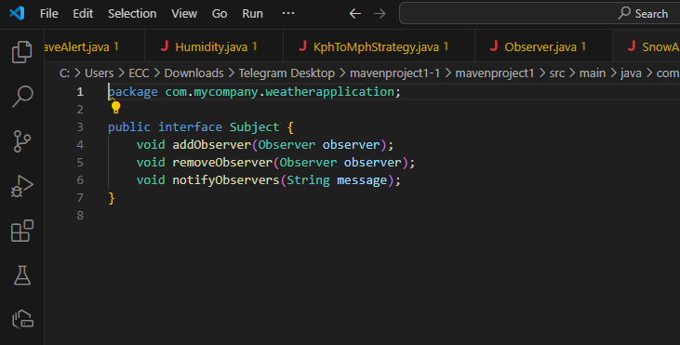
This code defines a Subject interface as part of the Observer Design Pattern.
Purpose:
The Subject represents an object that maintains a list of observers (other objects that are interested in changes).
It provides methods to add, remove, and notify these observers when something changes.
Key Functions:
addObserver: Adds an observer to the list so it can be notified of updates.
removeObserver: Removes an observer from the list.
notifyObservers: Sends a message to all observers, informing them of a change.
This design allows for automatic updates to multiple objects (observers) whenever the Subject changes.

Slide 12
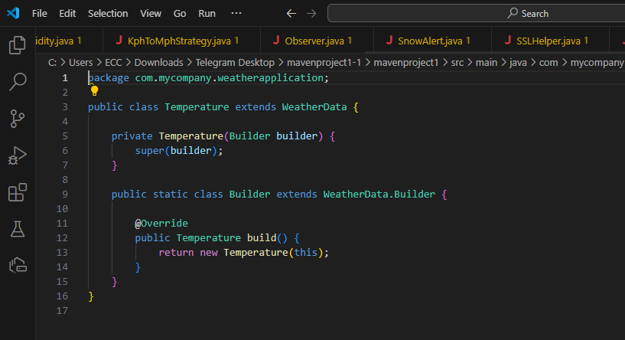
This code defines a Temperature class that represents temperature-related weather data, using the Builder Design Pattern.
Key Points:
Temperature Class:
It extends a parent class, WeatherData, which likely handles general weather information.
The constructor is private, meaning the Temperature object can only be created using the builder.
Builder Class:
This nested static class allows you to build a Temperature object step by step.
The build() method creates a new Temperature object using the builder.
Purpose:
This approach ensures that Temperature objects are created with consistent and customizable properties, allowing for flexibility when constructing weather data objects.

Slide 13
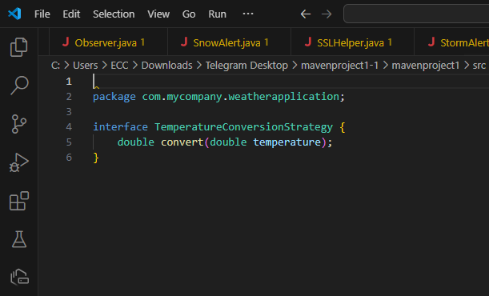
This code defines a TemperatureConversionStrategy interface.
Purpose:
The interface ensures that any class implementing it will have a convert method to perform temperature conversions.
Function:
The convert method takes a temperature value as input and returns the converted temperature as output.
This design allows different temperature conversion strategies (e.g., Celsius to Fahrenheit, Celsius to Kelvin) to be implemented in separate classes, providing flexibility and making it easy to switch between different conversion methods.

Slide 14
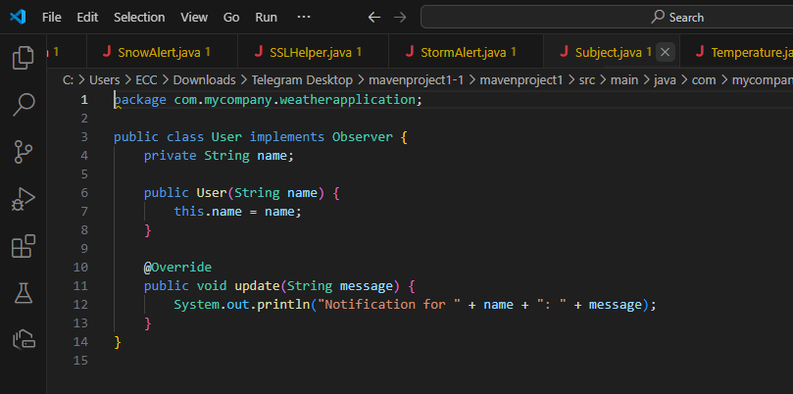
This code defines a User class that implements the Observer interface.
Key Points:
User Class: Represents a user who will receive notifications about changes.
Constructor: The user is initialized with a name.
update Method: When the user receives an update, this method displays a notification message with the user's name.
Purpose:
The User class acts as an observer in the Observer Design Pattern. It listens for updates and prints a notification whenever it receives a message, typically from a subject it is observing

Slide 15
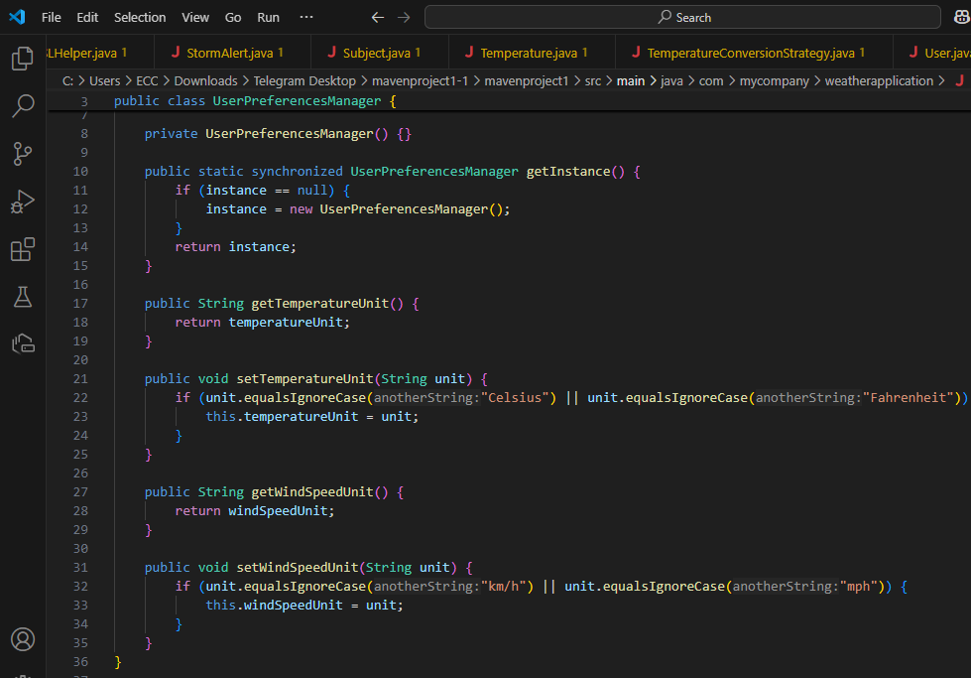
This code defines a UserPreferencesManager class that manages user preferences for temperature and wind speed units, following the Singleton Design Pattern.
Key Points:
Singleton Pattern: Ensures only one instance of UserPreferencesManager exists. The getInstance() method returns the single instance.
Private Constructor: The constructor is private to prevent creating multiple instances of the class.
User Preferences:
Temperature Unit: Stores the preferred unit for temperature (Celsius or Fahrenheit).
Wind Speed Unit: Stores the preferred unit for wind speed (km/h or mph).
Methods:
getTemperatureUnit() and getWindSpeedUnit() return the current unit preferences.
setTemperatureUnit() and setWindSpeedUnit() allow changing the preferences but only if the new unit is valid.
Purpose:
This class ensures that user preferences for units are consistently managed across the application, with only one instance handling all the preferences.

Slide 16
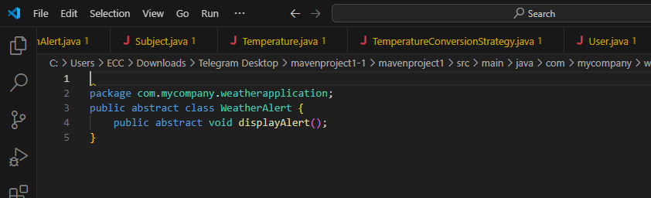
This code defines an abstract class WeatherAlert, which serves as a blueprint for specific types of weather alerts.
Key Points:
Abstract Class: Cannot be instantiated directly; it is meant to be extended by other classes.
displayAlert Method: An abstract method that must be implemented by any subclass to define how the alert will be displayed.
Purpose:
The WeatherAlert class provides a common structure for all weather alert types, ensuring that each alert has its own specific implementation of the displayAlert method.

Slide 17
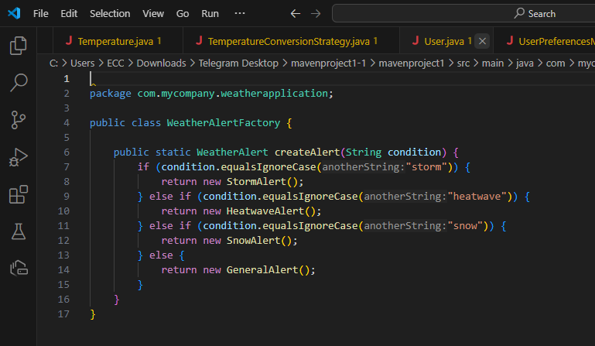
The WeatherAlertFactory class is a factory that creates weather alert objects based on a given condition.
Key Points:
Factory Method: The createAlert method takes a condition (e.g., "storm," "heatwave") and returns the appropriate WeatherAlert object.
Specific Alerts:
Returns a StormAlert for a storm condition.
Returns a HeatwaveAlert for a heatwave condition.
Returns a SnowAlert for a snow condition.
Returns a GeneralAlert if no specific condition matches.
Purpose:
This class centralizes the creation of weather alert objects, simplifying the process and ensuring the correct type of alert is created based on the input.

Slide 18
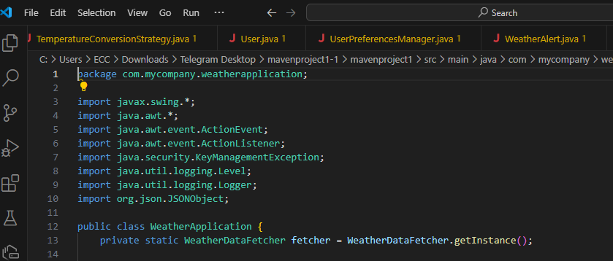
This code defines a graphical weather application using Java Swing that allows users to fetch and view weather information for a specific city. Here's the explanation in simple terms:
User Interface (UI):
The application has a user-friendly window (GUI) with inputs for the user's name, city, temperature unit, and wind speed unit.
It displays weather details like temperature, wind speed, humidity, and condition.
Customization:
Users can select temperature units (Celsius or Fahrenheit) and wind speed units (km/h or mph) to view data in their preferred format.
Weather Data Fetching:
The app uses a WeatherDataFetcher to fetch real-time weather information for the entered city from an external service.
Conversion:
Conversion strategies are applied to adjust temperature and wind speed based on user preferences.
Real-Time Updates:
When the user clicks the "Fetch Weather" button:
The app fetches data for the specified city.
Weather details are calculated and displayed based on the selected units.
Error Handling:
If the user does not provide all required inputs or if fetching the weather data fails, the app shows an error message.
Personalized Greeting:
The welcome message updates dynamically to greet the user by their name.
This code integrates a simple user interface with real-time weather functionality, offering a personalized and interactive weather experience.

Slide 19
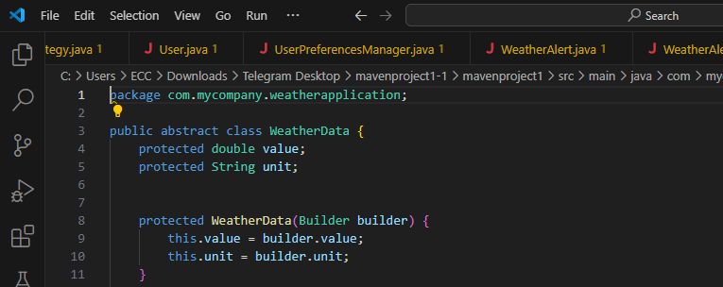
This code defines an abstract class WeatherData to represent general weather information, such as temperature or humidity. Here's the explanation in simple terms:
Weather Data Representation:
It stores a value (e.g., the numerical weather reading) and its unit (e.g., Celsius or Fahrenheit for temperature).
Builder Design Pattern:
The class uses a nested abstract Builder class to make it easier to construct weather data objects step by step.
The builder allows setting the value and unit for the weather data before creating the final object.
Flexibility:
Since WeatherData is abstract, it can be extended by specific weather data types (e.g., Temperature, Humidity), and each type will have its own Builder implementation.
Encapsulation:
The constructor is protected, so instances can only be created using the builder, ensuring controlled and consistent object creation.
This design provides a structured and reusable way to handle different types of weather data with shared functionality.

Slide 20
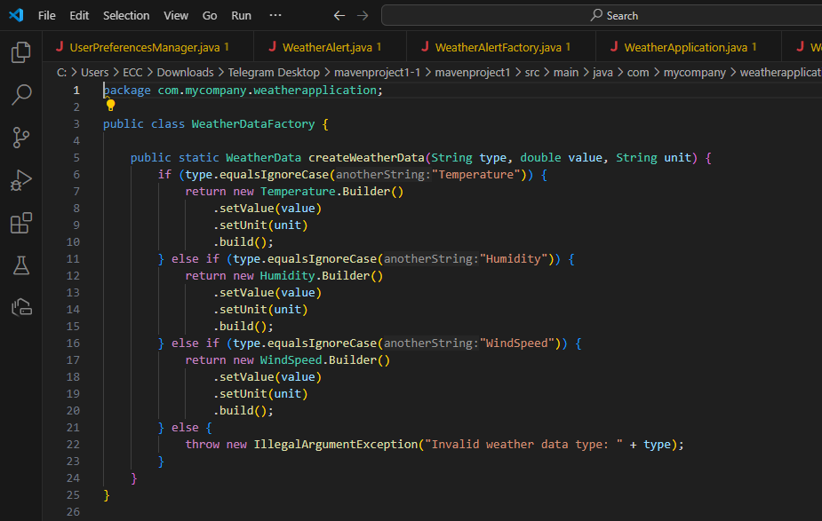
This code implements a factory class WeatherDataFactory to create various types of weather data objects in a simple and centralized way. Here's the explanation:
Purpose:
It simplifies the creation of different weather data types (Temperature, Humidity, WindSpeed) without needing to know the details of their construction.
How It Works:
The method createWeatherData takes three inputs:
The type of weather data (e.g., "Temperature").
The value (e.g., 25 for temperature, 50 for humidity).
The unit (e.g., "Celsius" for temperature or "km/h" for wind speed).
Based on the type, it uses the appropriate builder (Temperature.Builder, Humidity.Builder, etc.) to create and return the corresponding weather data object.
Error Handling:
If an invalid type is provided, it throws an exception to indicate the issue.
Advantages:
This design adheres to the Factory Pattern, making the code cleaner, reusable, and easier to extend when adding new types of weather data.

Slide 21
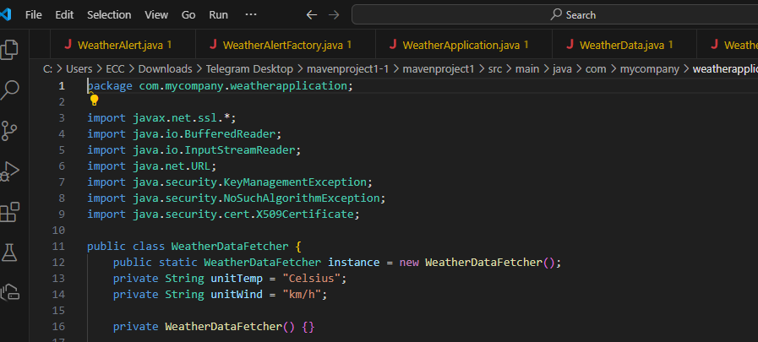
This code defines a class WeatherDataFetcher to fetch weather information from an external API. Here's a simplified explanation:
Purpose:
The class is designed to fetch current weather data for a specified location using a weather API.
Singleton Pattern:
Only one instance of WeatherDataFetcher is allowed, managed using the getInstance method. This ensures centralized control for fetching data.
Functionality:
It sets up secure HTTPS connections by overriding SSL and hostname verification (to allow access even in restrictive environments).
It sends a GET request to the weather API (weatherapi.com) with the location and API key.
The API response is read and returned as a JSON string.
Units Management:
It stores the preferred temperature unit (Celsius/Fahrenheit) and wind speed unit (km/h/mph), which can be set and retrieved.
Error Handling:
It includes basic exception handling to catch issues during SSL setup or API requests, logging errors instead of crashing the application.
API Key:
The class uses a specific API key to authenticate with the weather service.
This class acts as a bridge between the application and the weather API, fetching raw weather data in a secure and centralized manner.

Slide 22
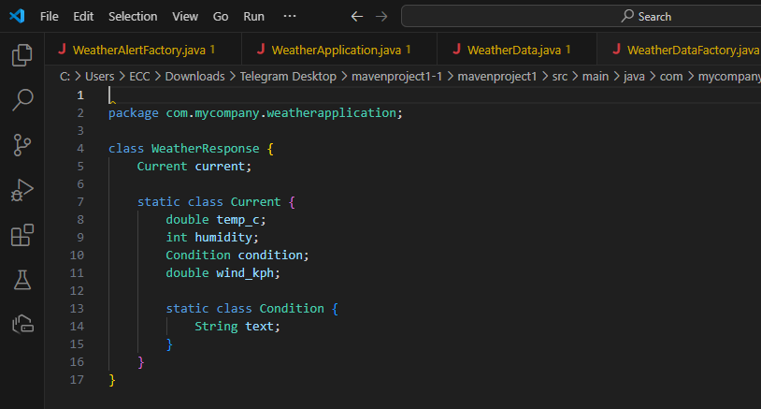
This code defines a WeatherResponse class to represent the structure of weather data retrieved from an API. Here's the explanation:
Purpose:
The class is used to map the JSON response from the weather API into Java objects.
Structure:
The outer class (WeatherResponse) contains a nested object called current, representing current weather data.
The Current class holds specific details:
temp_c: Temperature in Celsius.
humidity: Current humidity percentage.
wind_kph: Wind speed in kilometers per hour.
condition: A nested object representing weather conditions.
The Condition class contains:
text: A description of the weather (e.g., "Sunny", "Rainy").
Usage:
This structure mirrors the JSON format from the API response, making it easier to parse the data into these objects for further use in the application.
Essentially, it simplifies working with weather data by organizing it into Java objects with clear relationships.

Slide 23
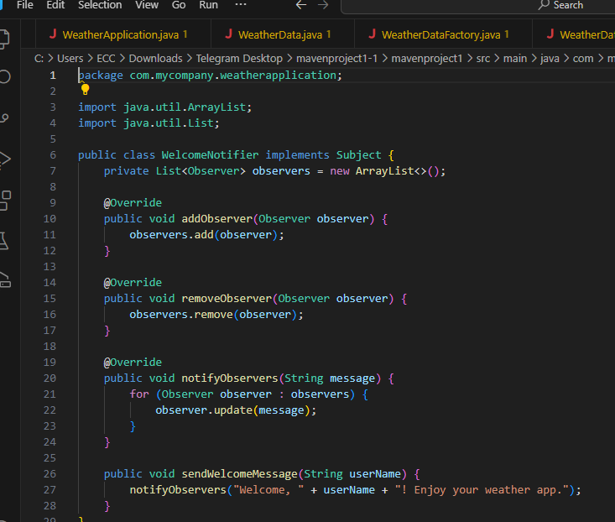
This code implements a WelcomeNotifier class to manage and notify a list of observers about welcome messages. Here's the explanation: Purpose: It uses the Observer Design Pattern to send welcome messages to multiple observers when a user joins the weather application. How it Works: Observers List: Maintains a list of objects (observers) that are interested in receiving notifications. Add/Remove Observers: Provides methods to add or remove observers. Notify Observers: Sends a message to all registered observers. Welcome Message: Generates and sends a personalized welcome message (e.g., "Welcome, John! Enjoy your weather app.") to all observers. Use Case: Ensures all registered components (observers) are updated automatically whenever a new user logs in and receives a welcome message. This class promotes loose coupling by allowing the notifier and observers to interact without knowing each other's details.

Slide 24
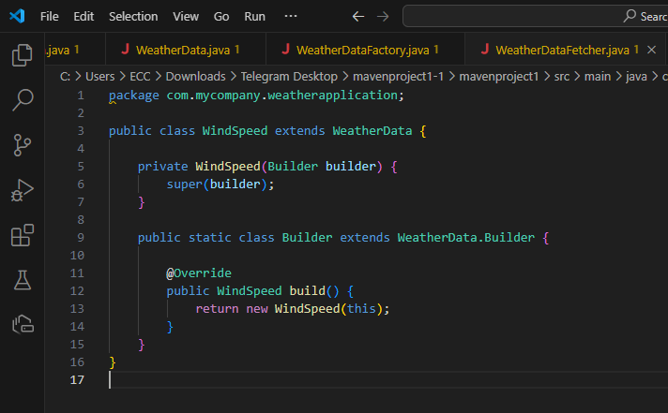
This code defines the WindSpeed class, which represents wind speed data. Here's the explanation: Purpose: To encapsulate wind speed information (value and unit) using the Builder Design Pattern. How it Works: WindSpeed Class: Extends the abstract WeatherData class, inheriting properties like value and unit. Builder Class: A nested class that helps in creating and initializing WindSpeed objects step by step. Build Method: Constructs a fully initialized WindSpeed object with the provided data. Use Case: Used when creating wind speed data with specific units (e.g., "km/h" or "mph"), ensuring flexibility and clarity in object construction.

Slide 25
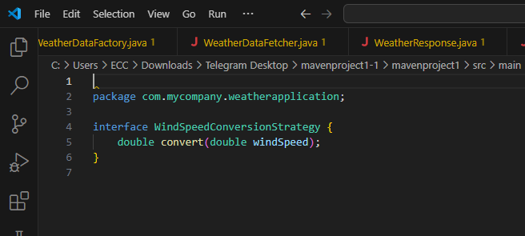
This code defines an interface called WindSpeedConversionStrategy. Here's its purpose in simple terms:
Purpose:
To provide a flexible framework for converting wind speed values between different units (e.g., km/h to mph).
How it Works:
The interface declares a single method, convert(double windSpeed), which is intended to be implemented by specific conversion strategies.
Use Case:
When you want to implement different ways of converting wind speed (e.g., from kilometers per hour to miles per hour or keeping it unchanged), each conversion logic is written as a separate class implementing this interface.
It supports adding new conversion methods without modifying existing code, adhering to the Open/Closed Principle.

